Slide 1
CHURN WITHIN TELECOM

Slide 2
Table of contents
01
02
03
04
The Business
The Data
Business Overview
Business Problem
Overview
Analysis
Conclusions
Performance
Optimization
Recommendation(s)
Next Steps

Slide 3

The Business
Syriatel is a mobile network provider based in Syria.
One of two providers within Syria
In 2017 introduced 4G speeds, branded Super Surf

Slide 4
Churn
Attrition or customer churn, is the rate at which customers stop doing business with an entity.

Slide 5
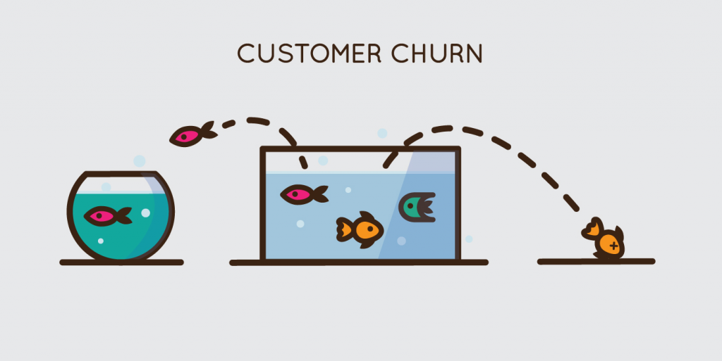

Slide 6
Business Problem
Classification
Identification
Retention
Can we classify or predict customers who will churn?
Can we identify reason(s) for customer churn?
What effective measures can we use to retain customers

Slide 7
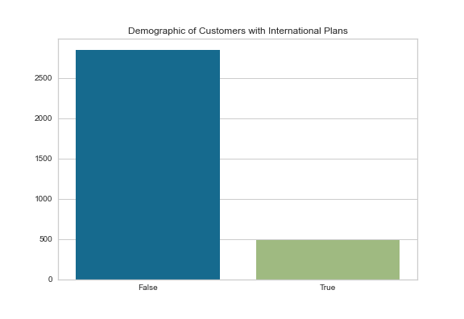
Data Overview
Data
3000+ Observations
No missing values
Target
Churn
14.5% Churn rate

Slide 8
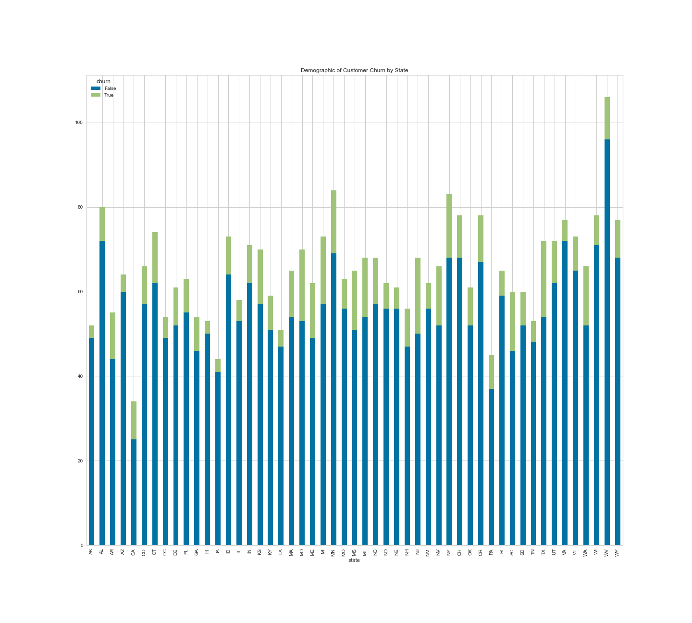

Slide 9
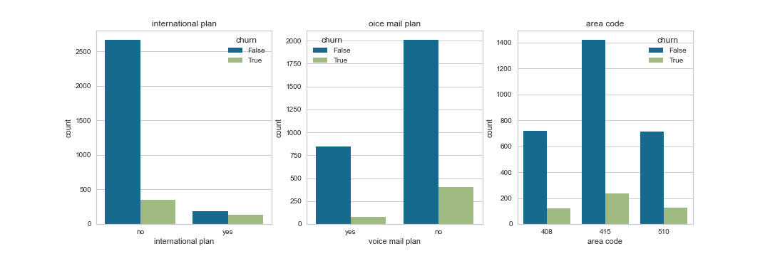

Slide 10
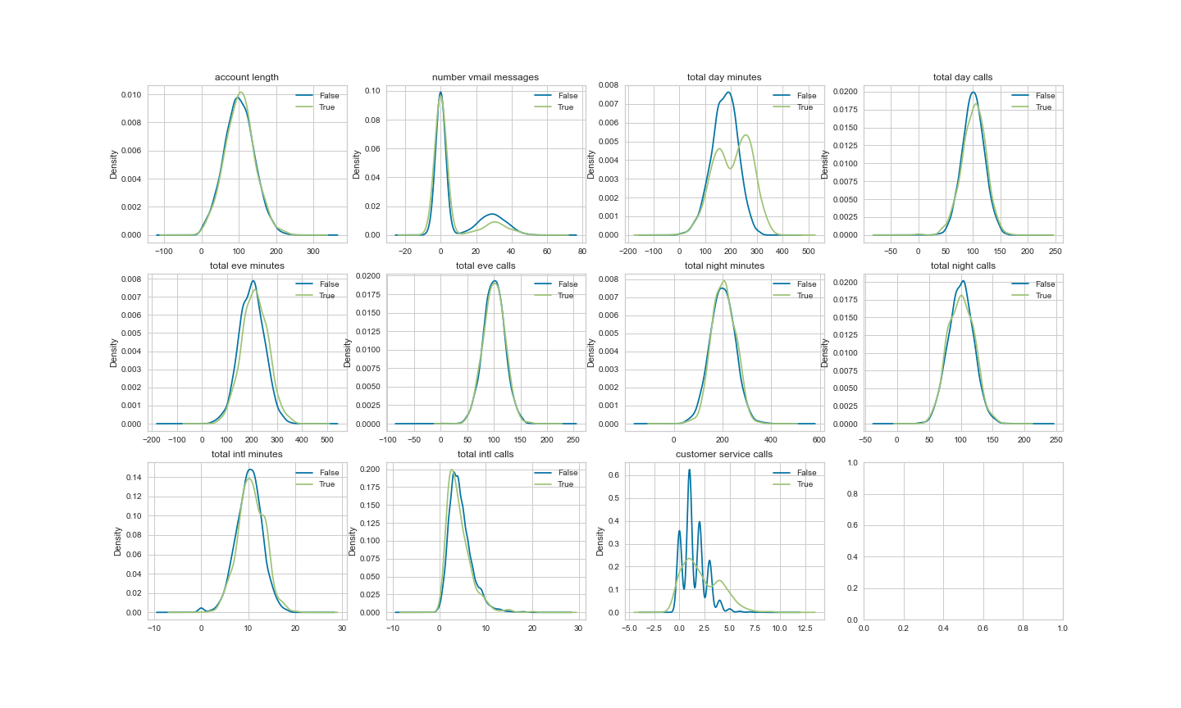

Slide 11
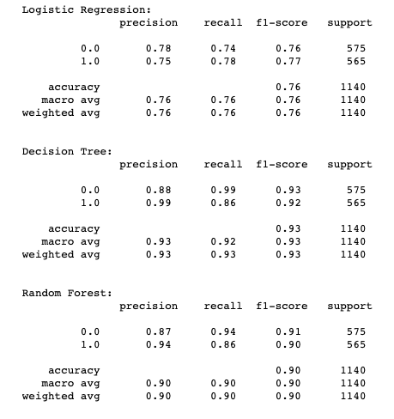
Performance of Base Models
Random Forest
Logistic Regression
86%
78%
86%
Random Forest

Slide 12
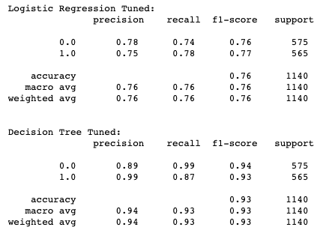
Performance of Tuned Models
78%
Logistic Regression with GridSearch CV
87%
Decision Tree with GridSearch CV

Slide 13
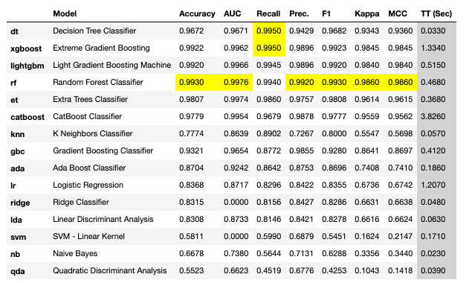
Optimization (PyCaret)

Slide 14
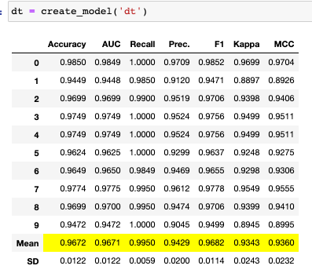
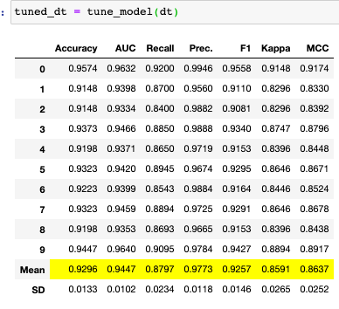
Base DT -vs- Tuned DT

Slide 15
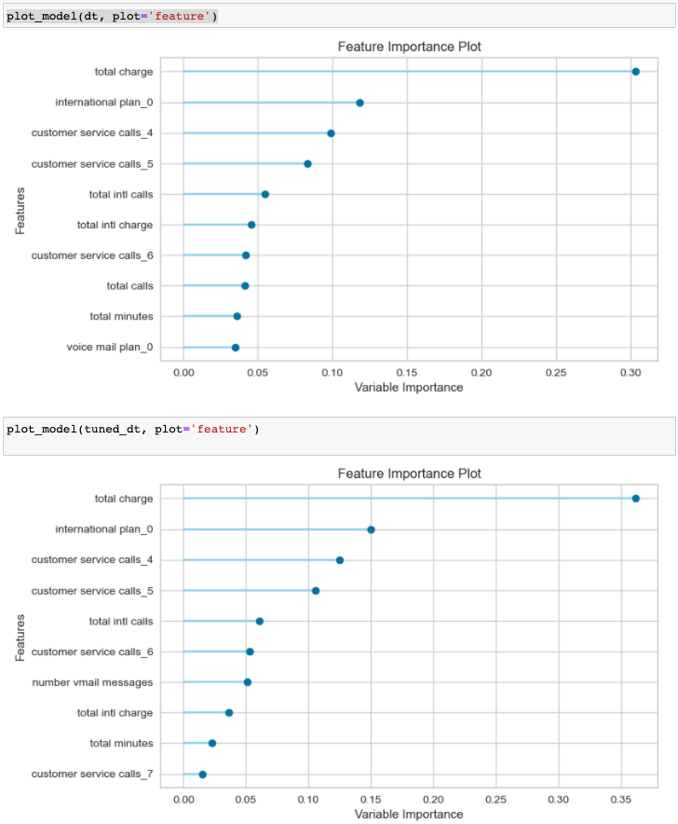
Feature Importance

Slide 16
Recommendations
01
02
Customer Service
The company needs to potentially focus its efforts in reducing customer service calls.
Sales
Clients with international plans do play a part in customer retention.
Business Model Enhancements

Slide 17
Next Steps
Value
Connect
Storytelling
Application of PyCaret as tool
Connect with stakeholders to gain more insight
Understanding the customer journey and voice
Competition
Capture
Versioning
Understanding other competitors and forecasting trends
Capture trends within the telecom space and subscription based business models
Testing new models with new data

Slide 18
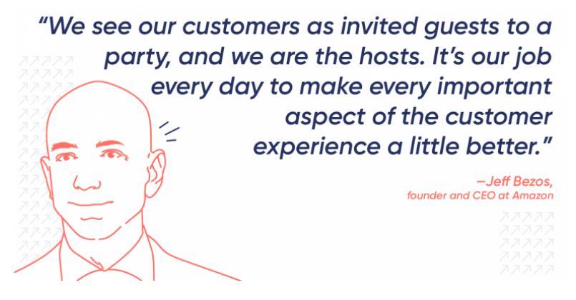

Slide 19

Thanks
Christian Corrales
corrales.christian1228@gmail.com

